Slide 1
Telecom Industry Customer Churn Prediction
Team Number: 6
Submitted for DATS 6101

Slide 2
AGENDA
Dataset
SMART Questions
Preprocessing and EDA
Algorithms used to Predict Customer Churn:
Logistic Regression
Decision Tree
KNN

Slide 3
Dataset
The data set includes information about:
Customer Demographic Information – gender, age range, partners, dependents
Customer Account Information – tenure, payment method, paperless billing, monthly charges, and total charges
Services – phone, multiple lines, internet, online security, online backup, device protection, tech support, and streaming TV and movies
Churn – Customers who left within the last month (target column)
Data Dimensions: 7043 rows (customers) and 20 columns (features)
Source : http://community.ibm.com/community/user/businessanalytics/blogs/steven-macko/2019/07/11/telco-customer-churn-1113

Slide 4
SMART Questions
Do customer demographics, certain services, tenure, monthly charges affect churn?
Can we reliably predict if a customer will churn using different Machine Learning algorithms? (Logistic Regression, Decision Tree Classification, KNN)

Slide 5
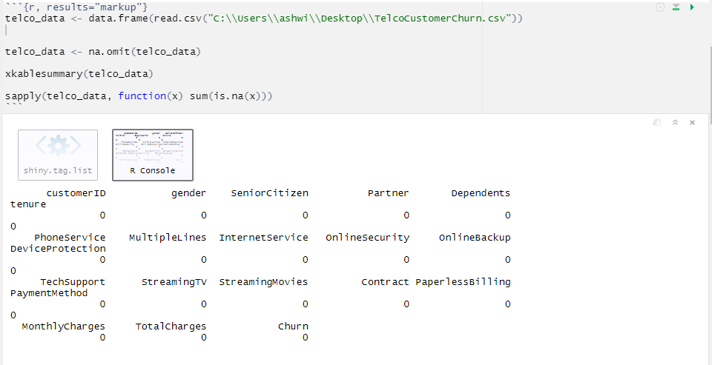
Preprocessing
There are 11 missing data points in the TotalCharges column. We remove these as it's a very small percentage of the whole dataset.

Slide 6
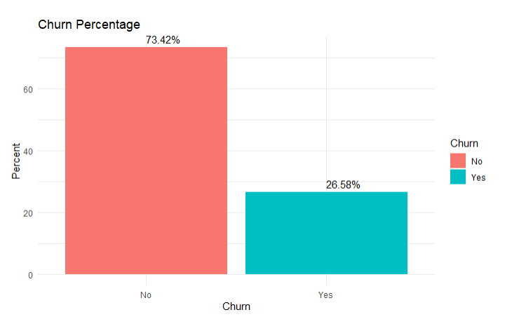
EDA – Overall
26.58% of the customers from the dataset have stopped using the services offered by the Telecom company.

Slide 7
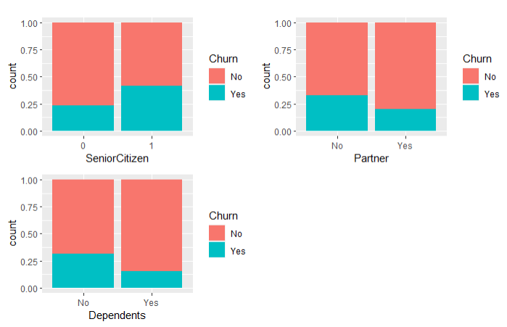
EDA – Customer Demographic Information
Churn percentage is higher in case of senior citizen
Customers with partners or dependents have a lower churn percentage as compared to those who don’t

Slide 8
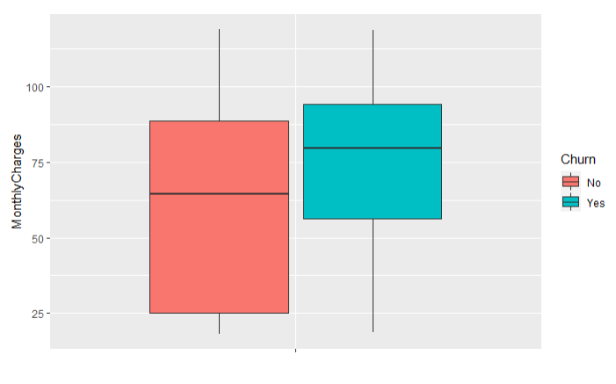
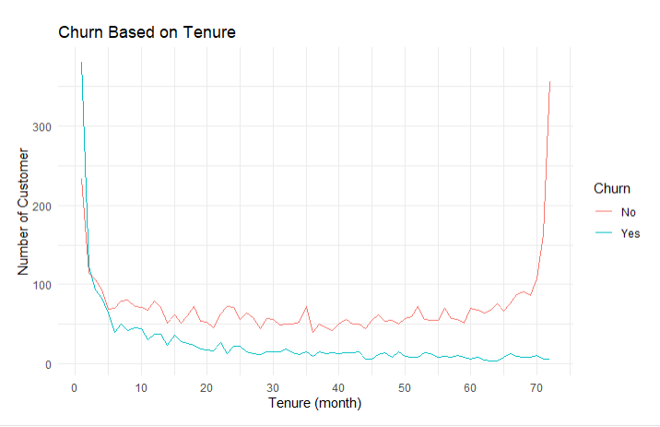
EDA – Customer Account Information
Churn rate is high for customers having high monthly charges
Highest number of customers churn between 1-5 months of their tenure with the company.

Slide 9
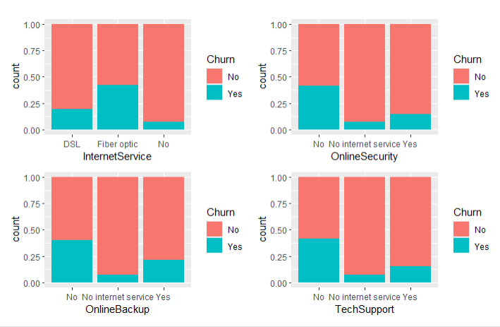
EDA – Services
Churn percentage is higher for customers using “Fiber optic” internet services
Customers who opt out of services like OnlineSecurity , OnlineBackup and TechSupport have a higher churn rate

Slide 10
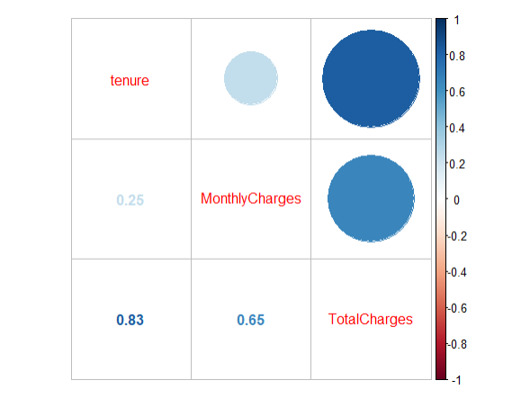
EDA - Correlation
Correlation Matrix – Numerical Variables
Highly correlation - tenure and TotalCharges.
Moderately correlation - MonthlyCharges and TotalCharges.

Slide 11
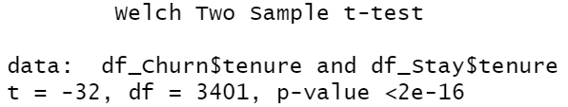
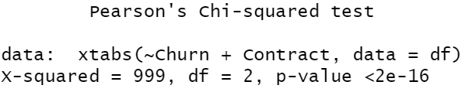




Logistic Regression

Slide 12
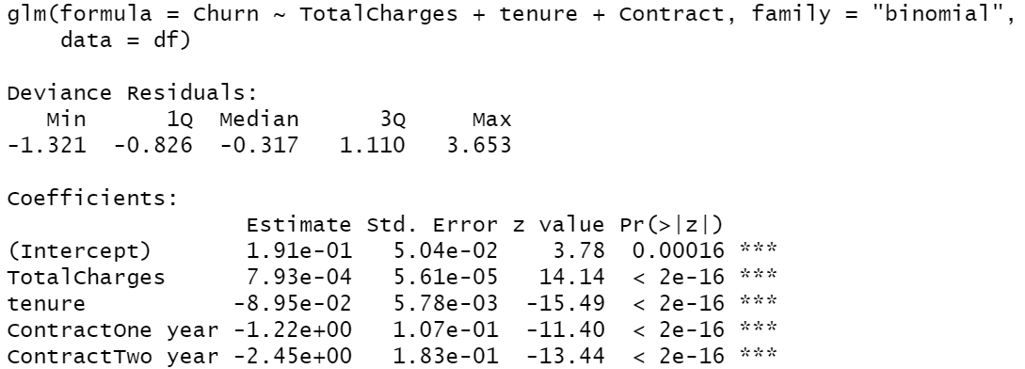
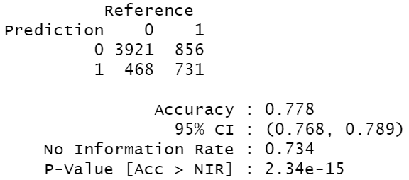
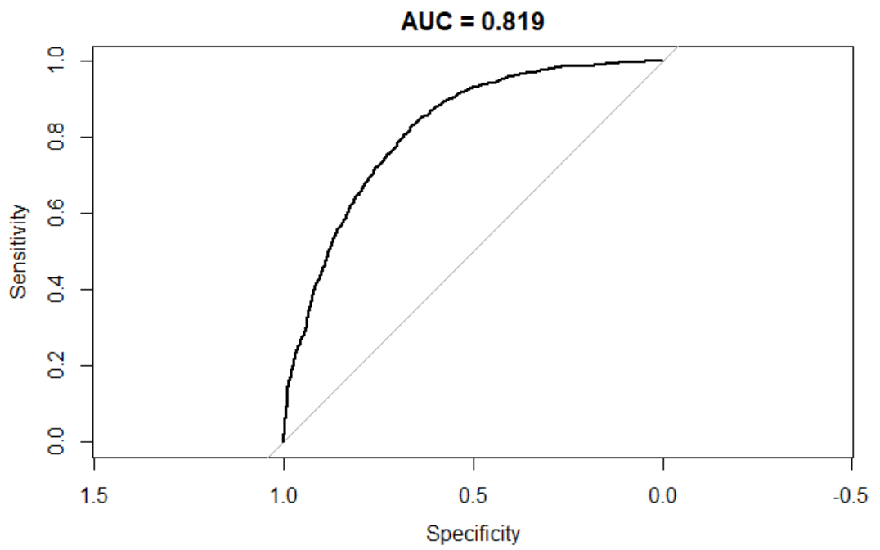
Logistic Regression
Long term customer have better loyalty.
Look for False Negative
Pseudo R²: 0.217

Slide 13
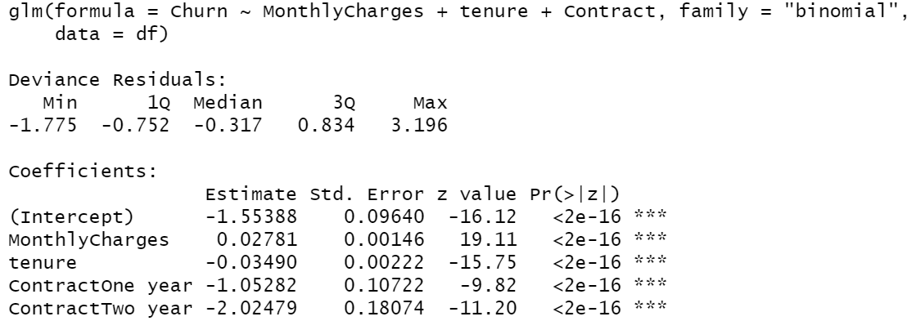
Logistic Regression
Use Monthly Charges as predictor is much easier to interpret, since people are likely to be more sensitive to marginal cost. But may hurt model accuracy in bigger models.
Prediction Accuracy vs. Interpretability

Slide 14
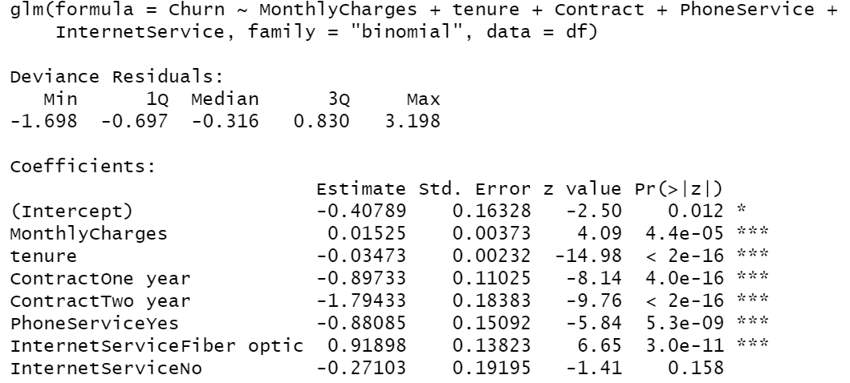
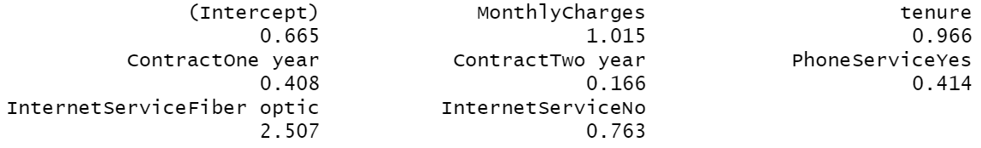
Logistic Regression
Good Job to Phone Dpt. & Investigate Internet Service Dpt. Now!
Highly likely due to overpricing of Fiber Optic connection compared with competition.

Slide 15
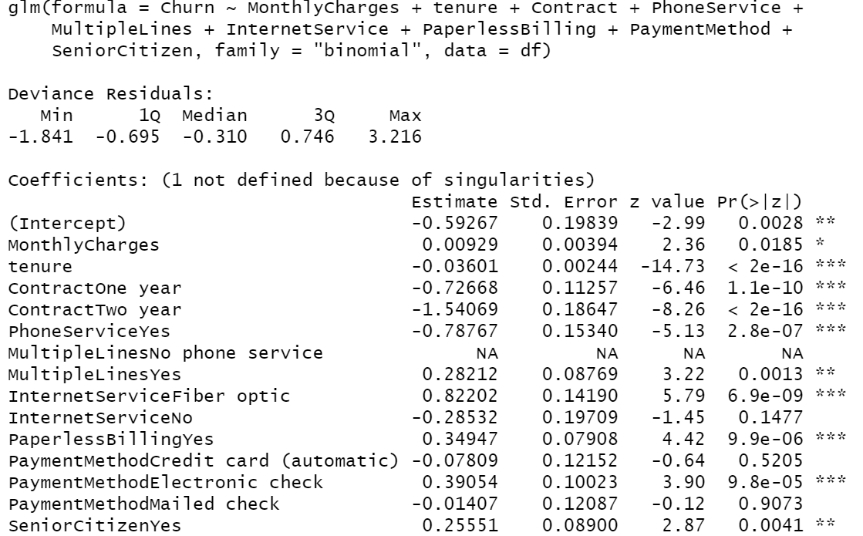
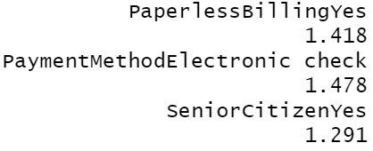
Logistic Regression
Pseudo R²: 0.269
AUC: 0.838
Accuracy: 0.8
False Negative: 755
Provide Discount to App users and Seniors

Slide 16
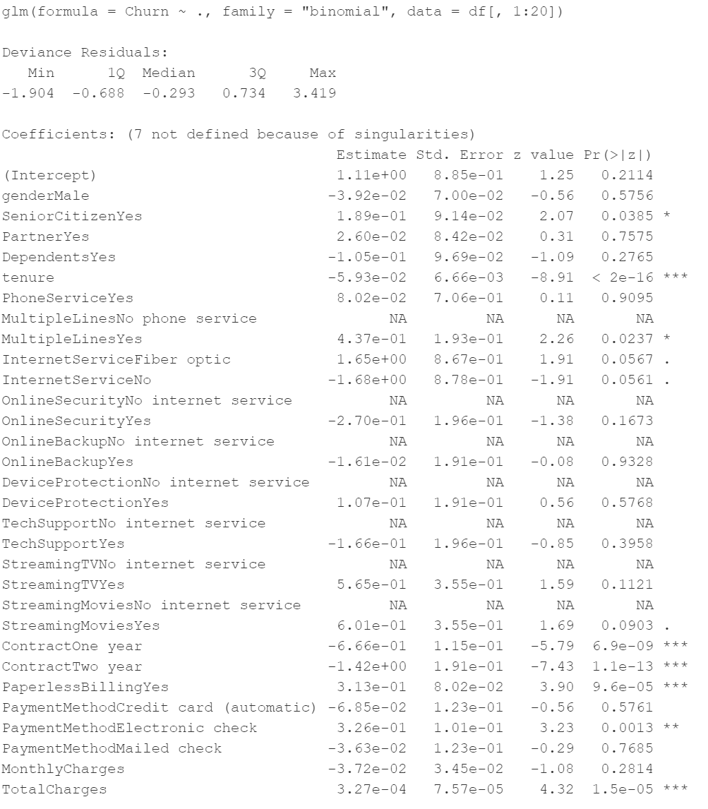
Logistic Regression
Full Model:
Pseudo R²: 0.279
AUC: 0.845
Accuracy: 0.804
False Negative: 724
Full model improves prediction accuracy and False Negative rates, improves pseudo R² and AUC, but harms interpretation.

Slide 17
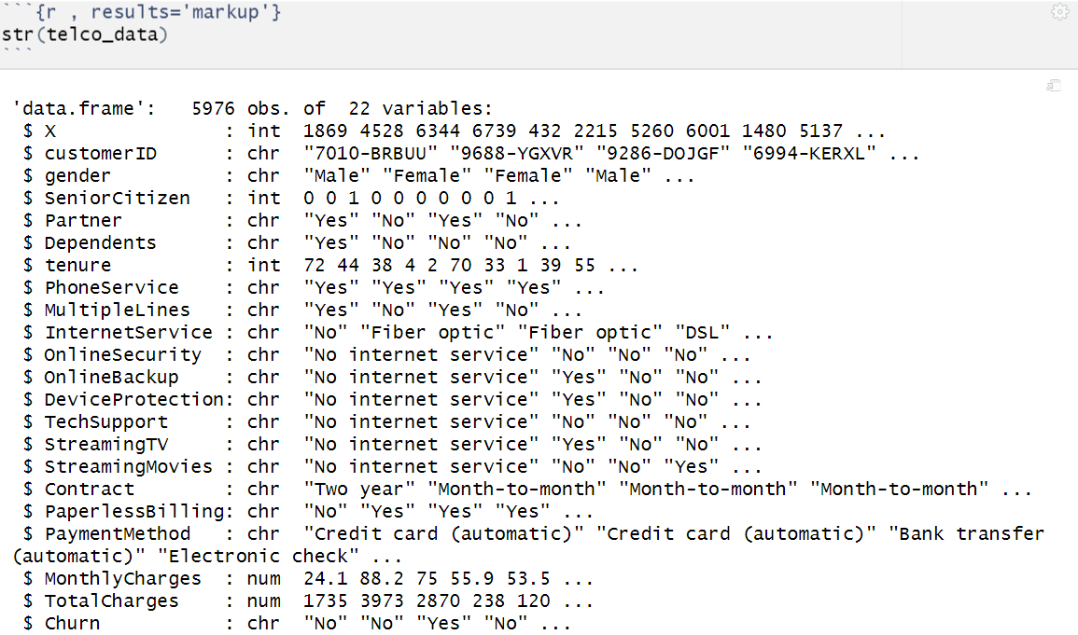
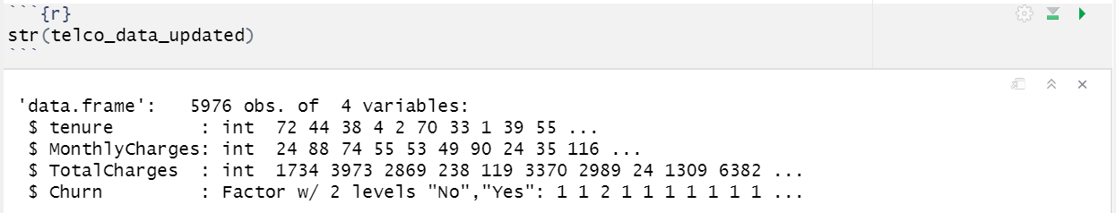
KNN Model-Data Selection/Validation

Slide 18
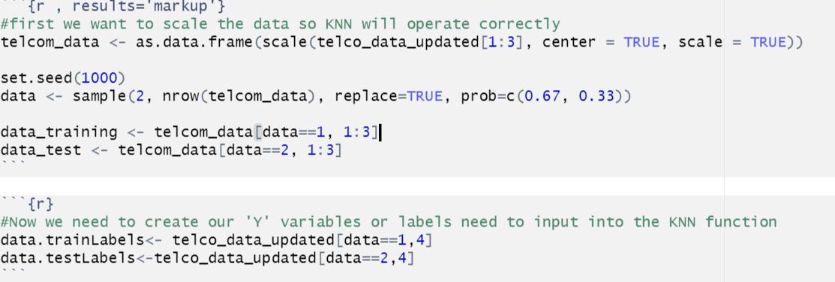
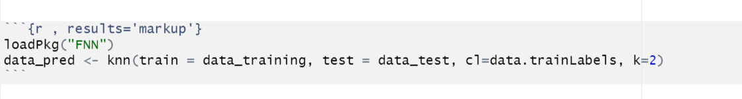
KNN Model-Model Building

Slide 19
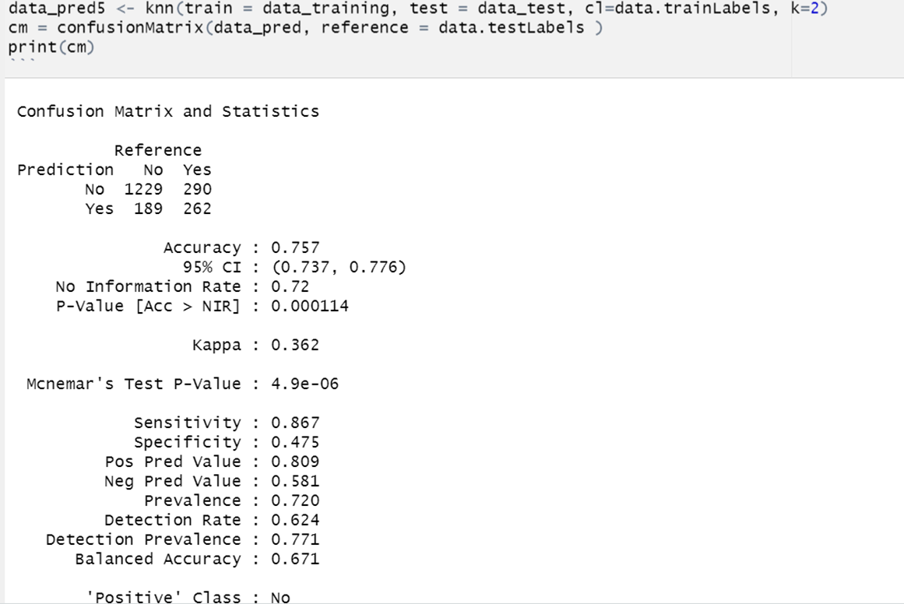
KNN Model-Confusion Matrix-Accuracy

Slide 20
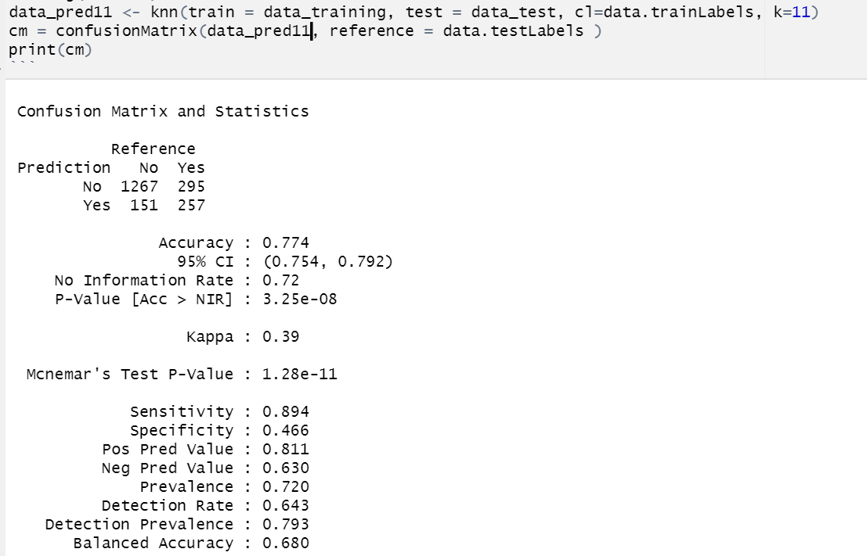
KNN Model-Confusion Matrix-Accuracy

Slide 21
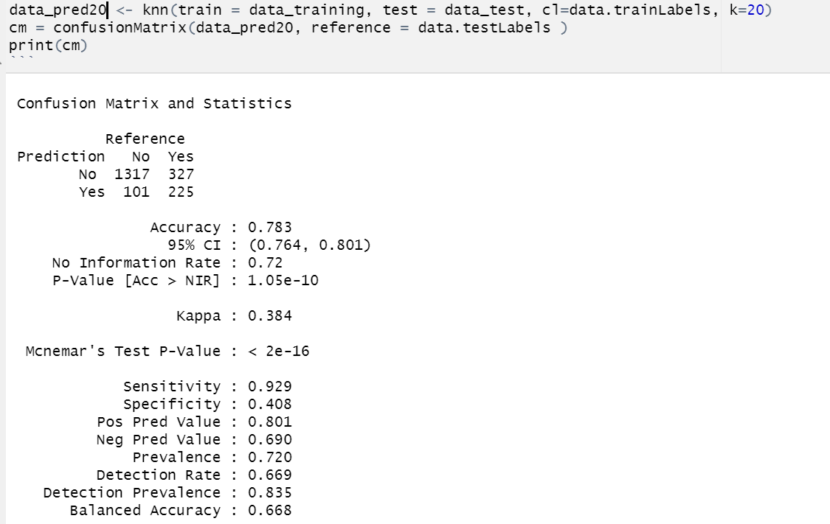
KNN Model-Confusion Matrix-Accuracy

Slide 22
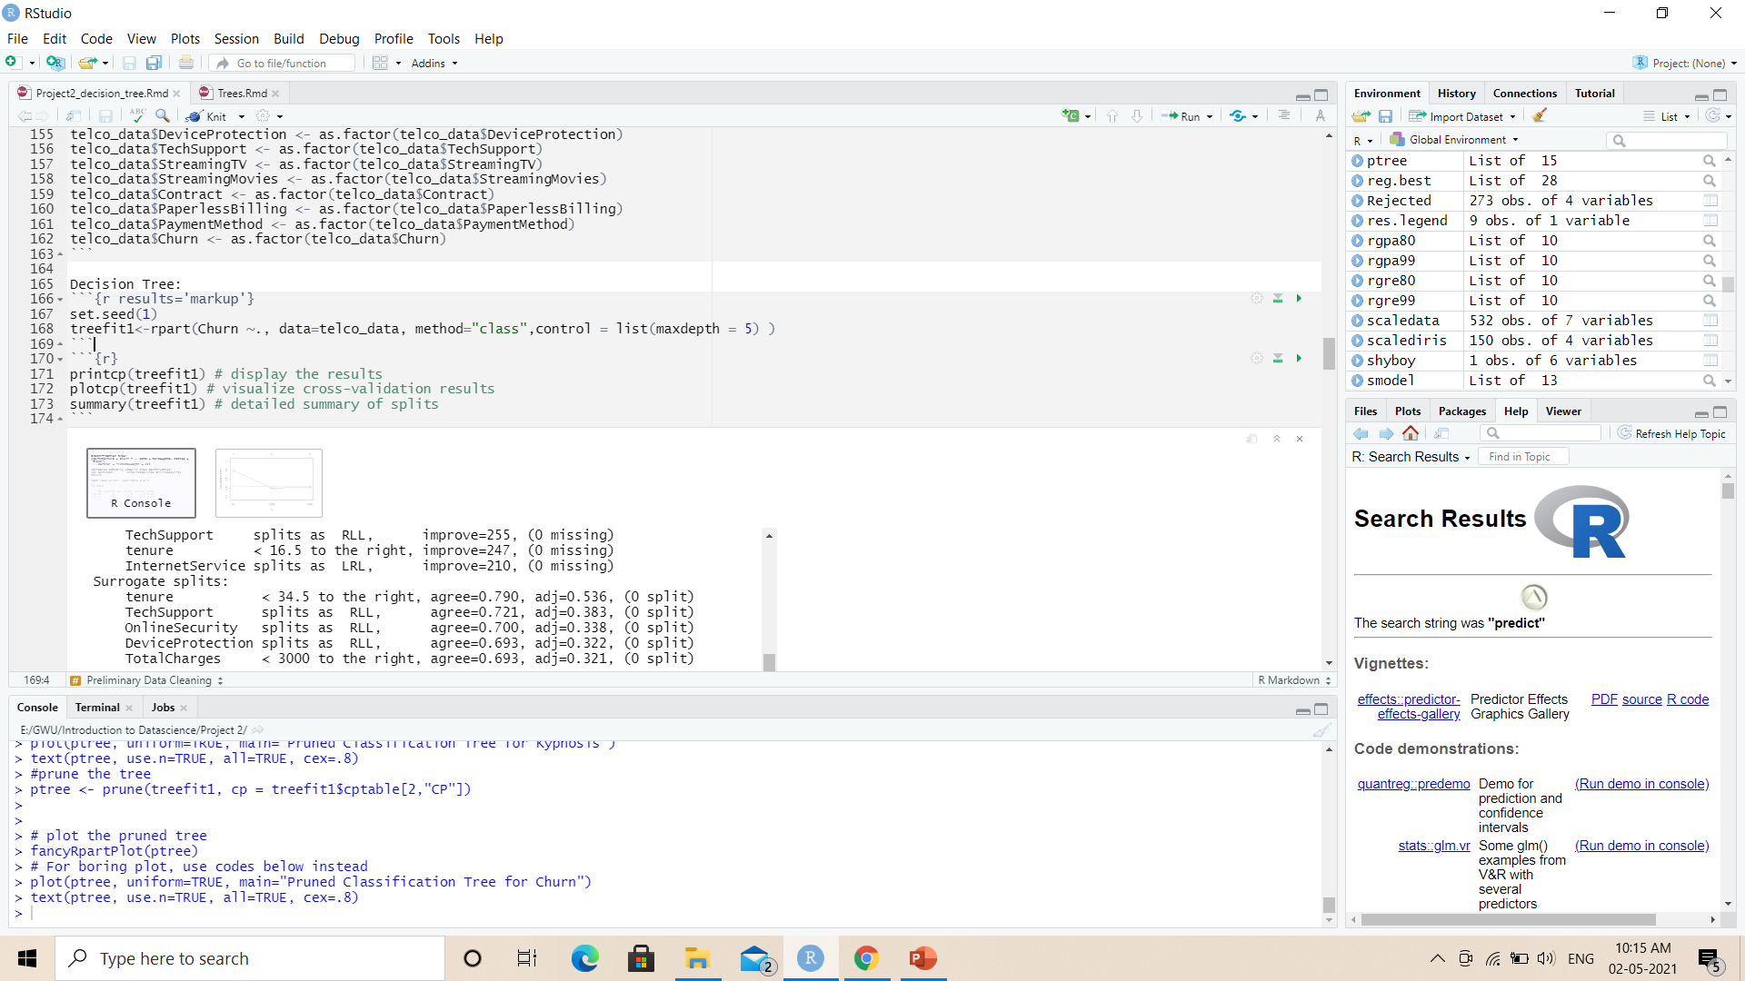
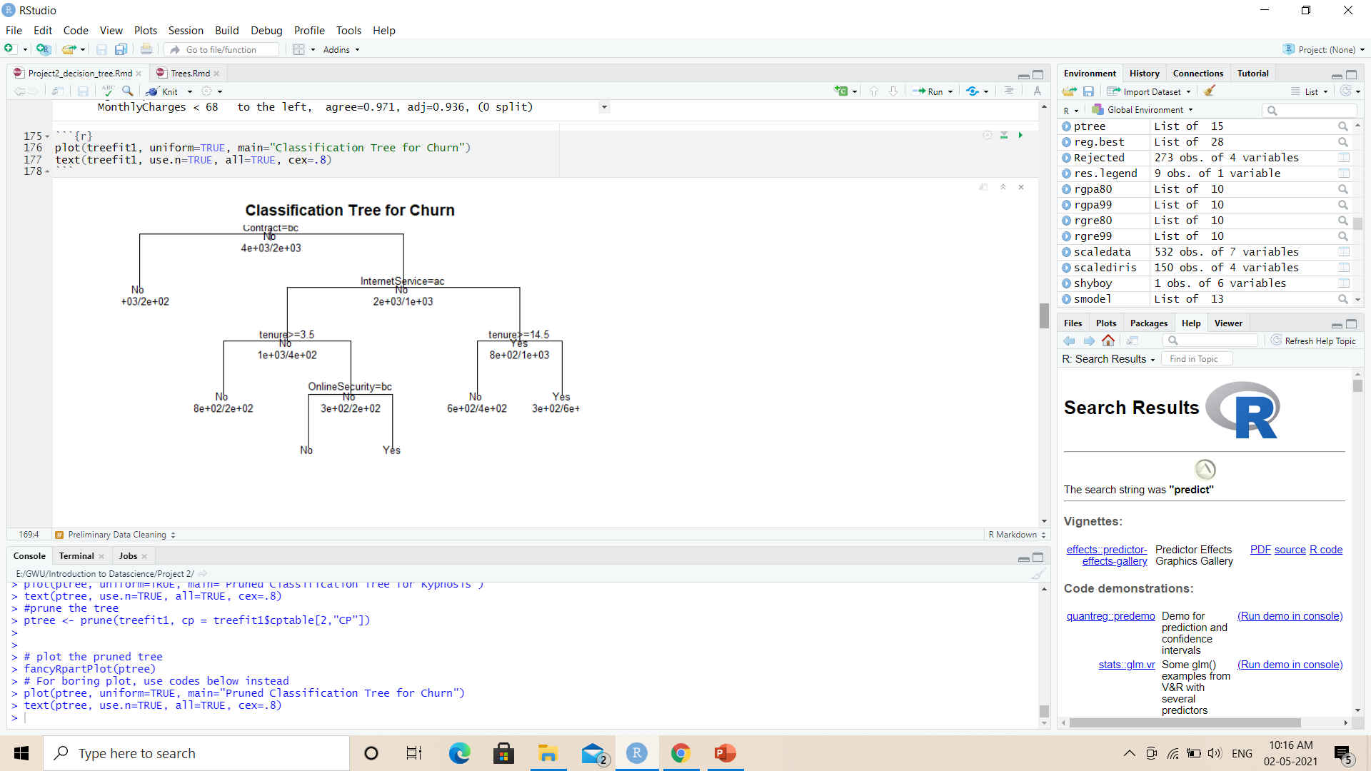
Decision Tree Model

Slide 23
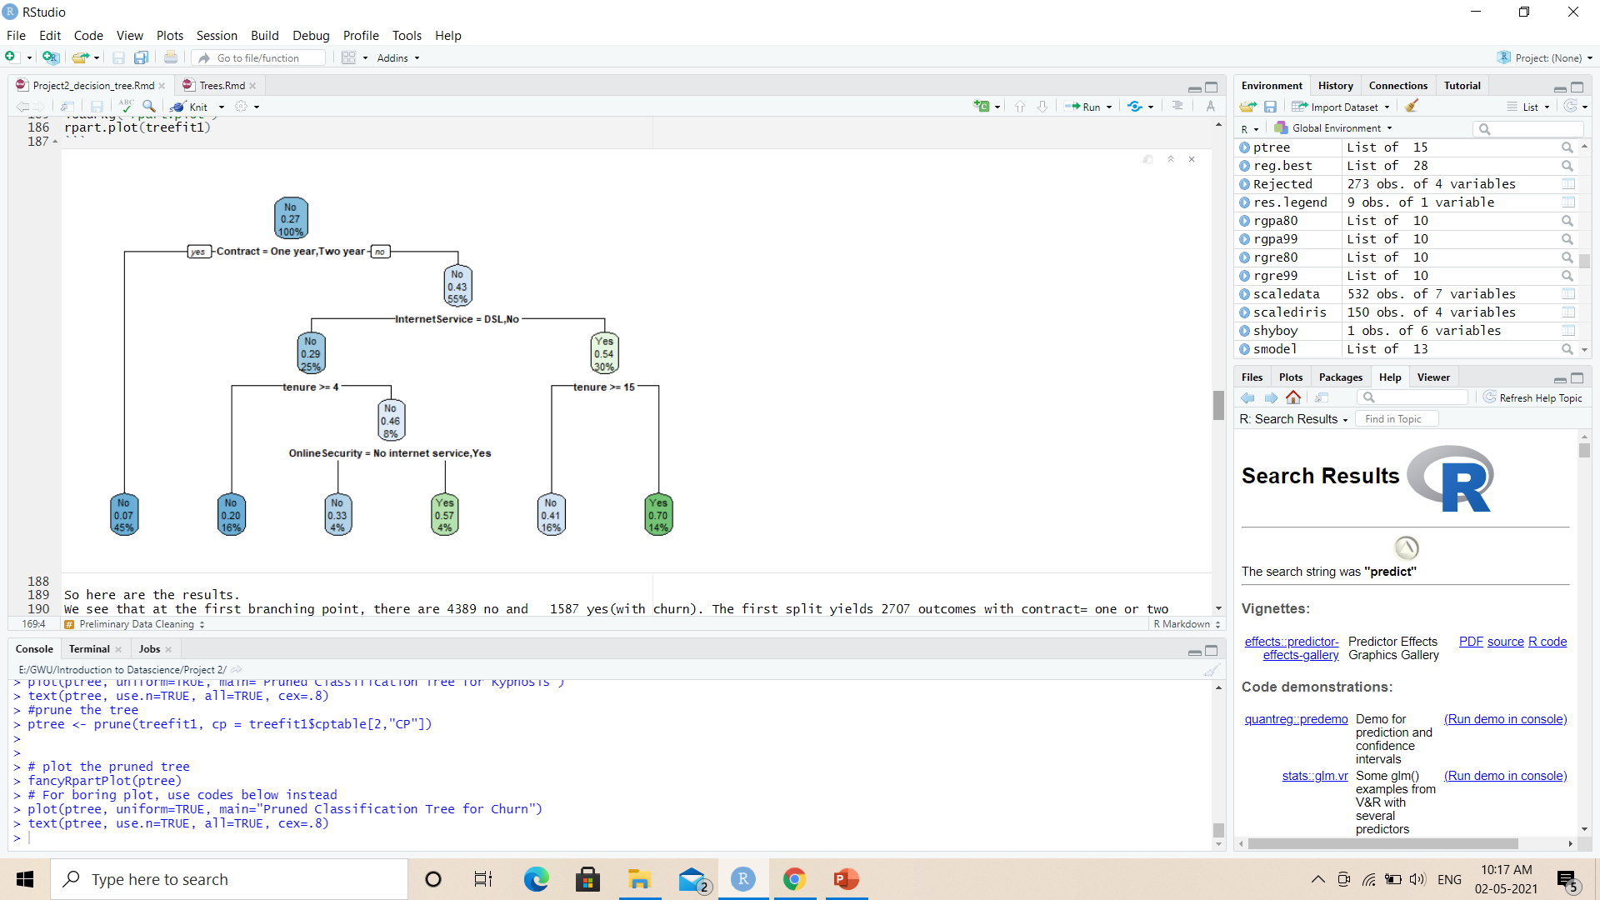
Decision Tree Model
The first branching point, there are 4389 no and 1587 yes (churn)
The first split yields 2707 outcomes with contract= one or two years and 3269 outcomes with contract= month to month

Slide 24
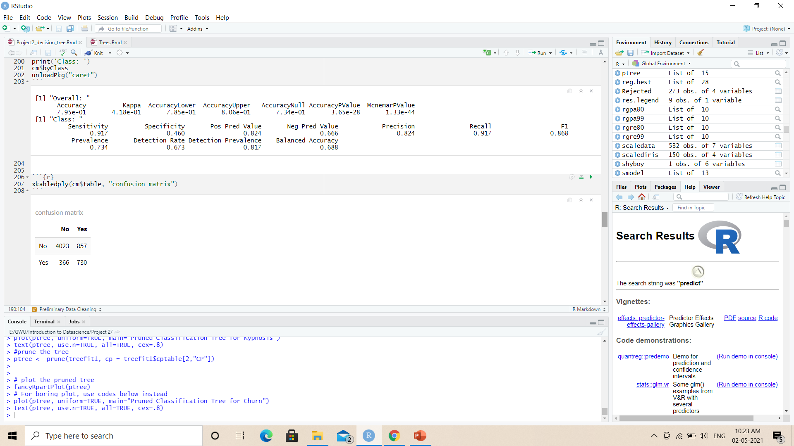

Decision Tree Model
The overall accuracy of model is 79.5%

Slide 25
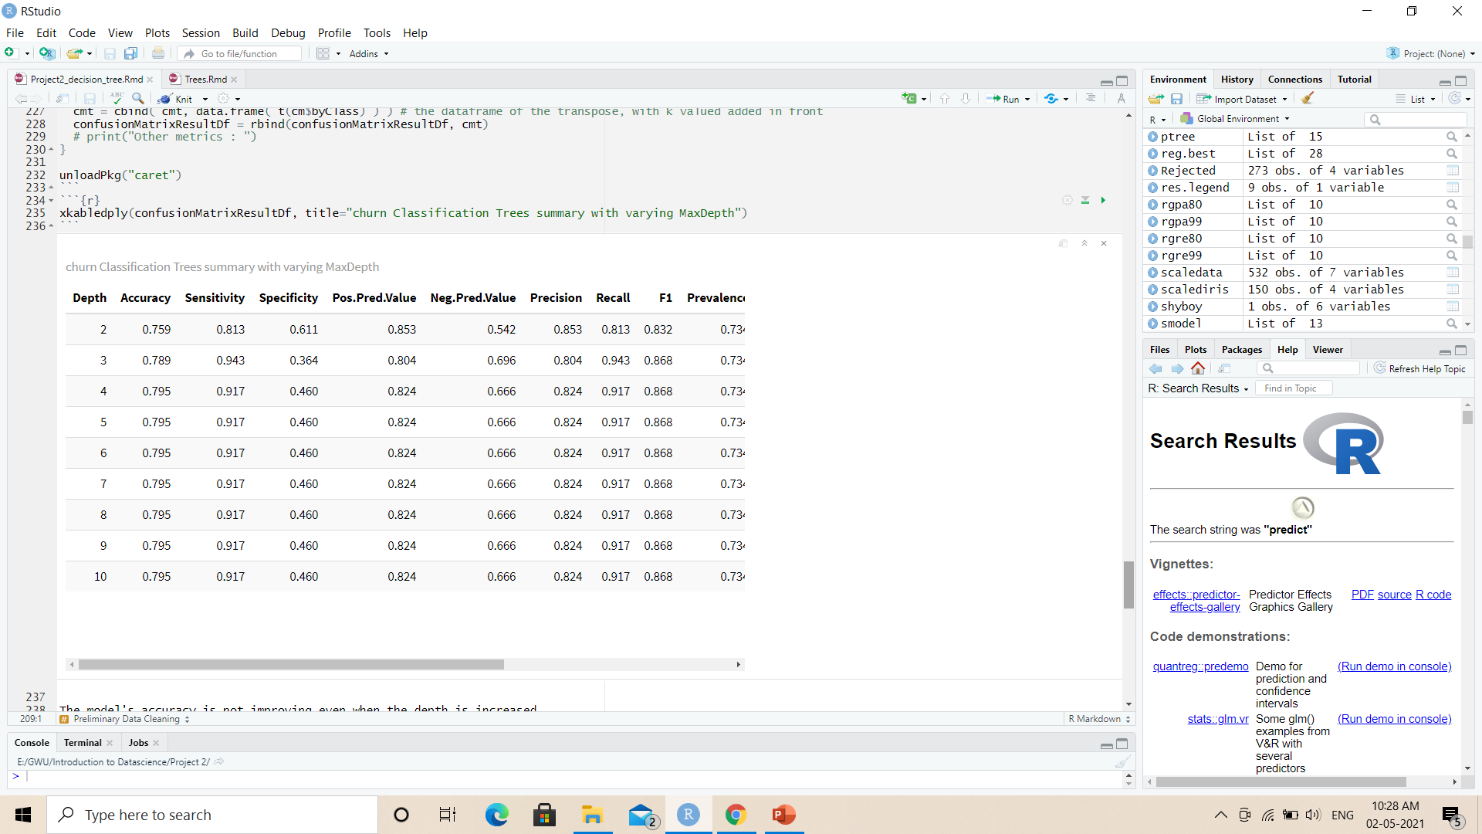
Decision Tree Model
Let us try different maxdepths to check whether there is an improvement in model
The model's accuracy is not improving even when the depth is increased.

Slide 26
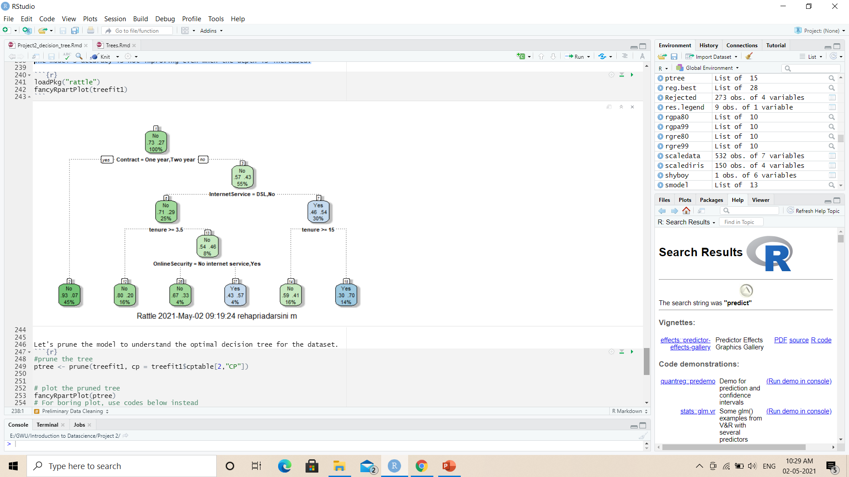
Final Decision Tree Model

Slide 27
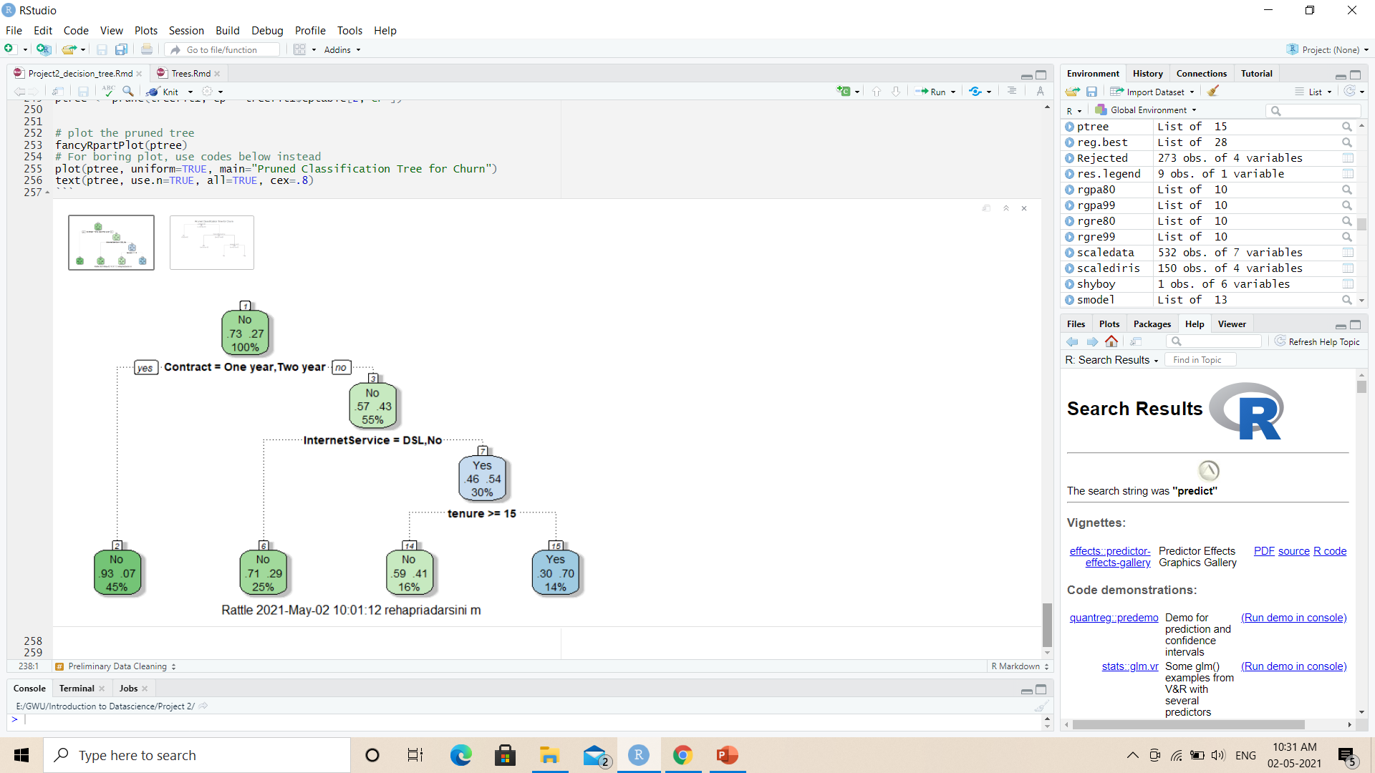
Pruned Tree

Slide 28

GitHub
GitHub link:
https://github.com/adingankar/DATASCIENCE_6101/tree/main/Project%202

Slide 29
Any Questions?

